Slide 1
CCBDA
Final Project
Aleix Boné Ribó
Alba Cañete Garrucho
Riccardo Cecco
Marc Manzanares Díez
Oriol Martínez Acón
Spring 2022
MIRI - Master in Data Science
FIB - UPC

Slide 2
Outline
Introduction
Development methodology
Application functionalities
ML model
Infrastructure/devops
Future work
Conclusions

Slide 3

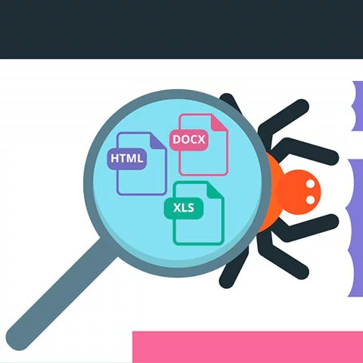

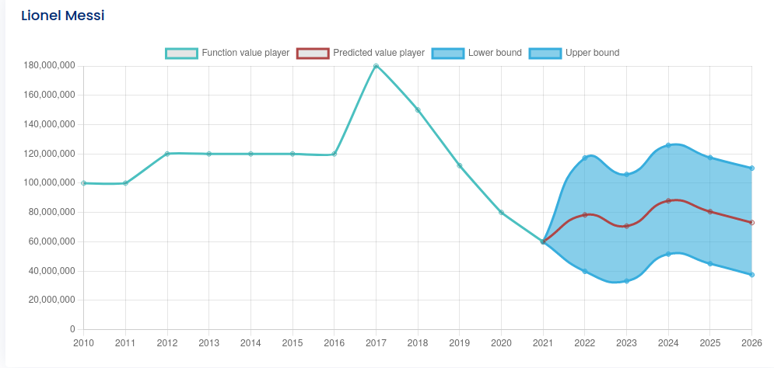
Introduction
Notes:
Rick

Slide 4





Data
Championships:
Years: 2010 to 2022
Data of the teams:
Data of the players:
Notes:
Rick

Slide 5

Development methodology: AGILE
Notes:
Rick

Slide 6
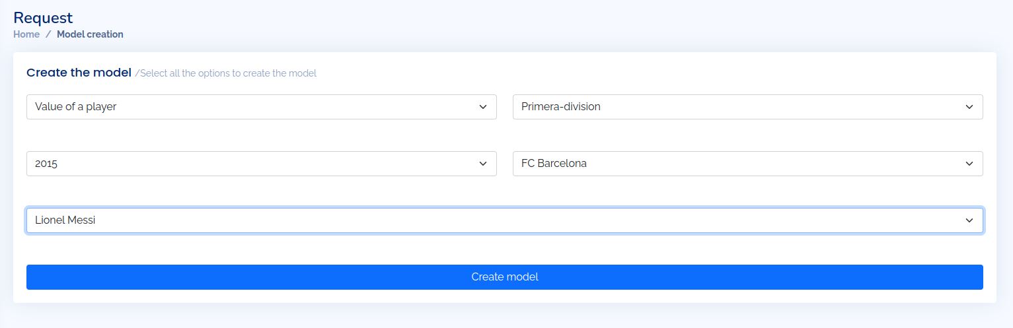
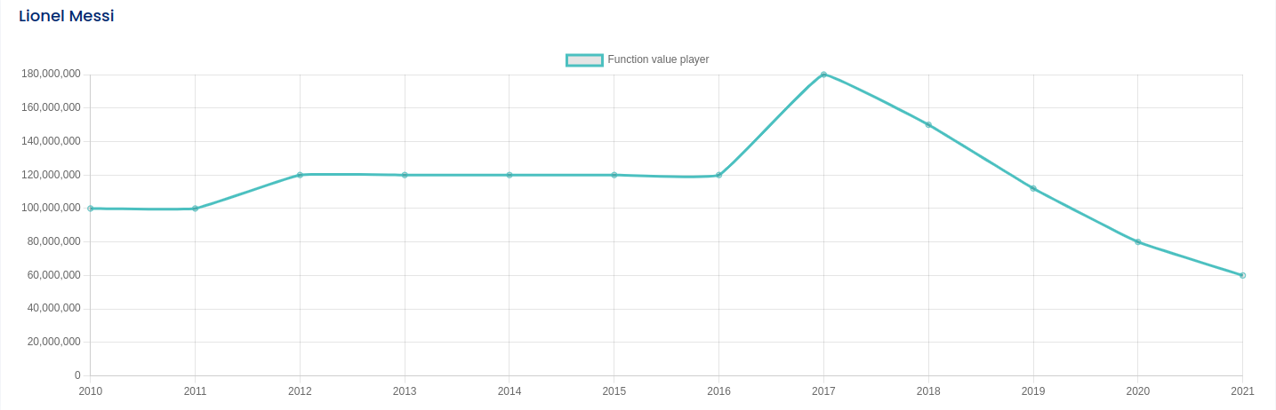
Application functionalities (1)
User interaction to store all the necessary information.
Requests to create plots by the gathered data.

Slide 7
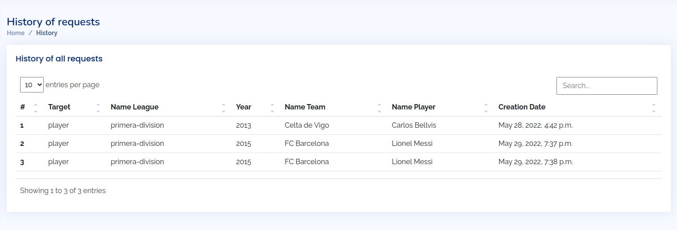
Application functionalities(2)
History of all the requests

Slide 8


ML model
Inspect the data
Transform and join data
Build and train models
Find best model configuration
Deploy the model

Slide 9
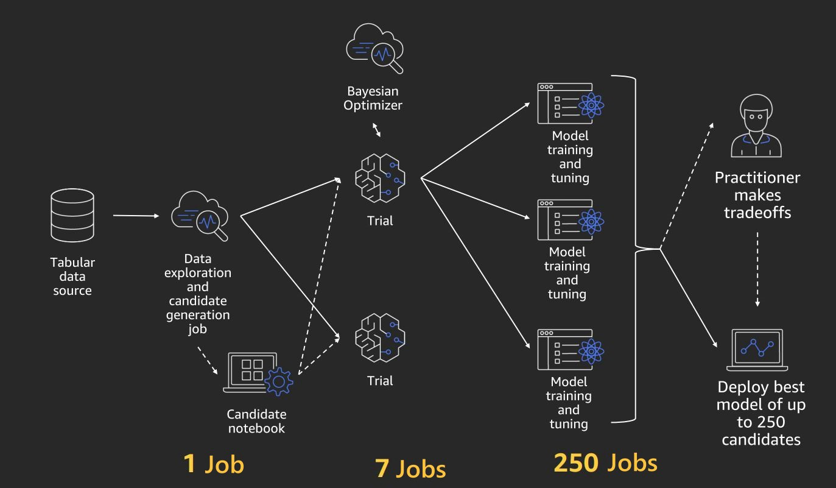
ML model - Running Autopilot

Slide 10
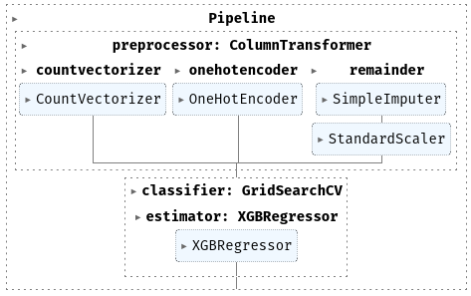
ML model - selecting best model
R2=0.63
Needs goals, assists, minutes played to work
We need forecasting of multiple values based on player trends

Slide 11
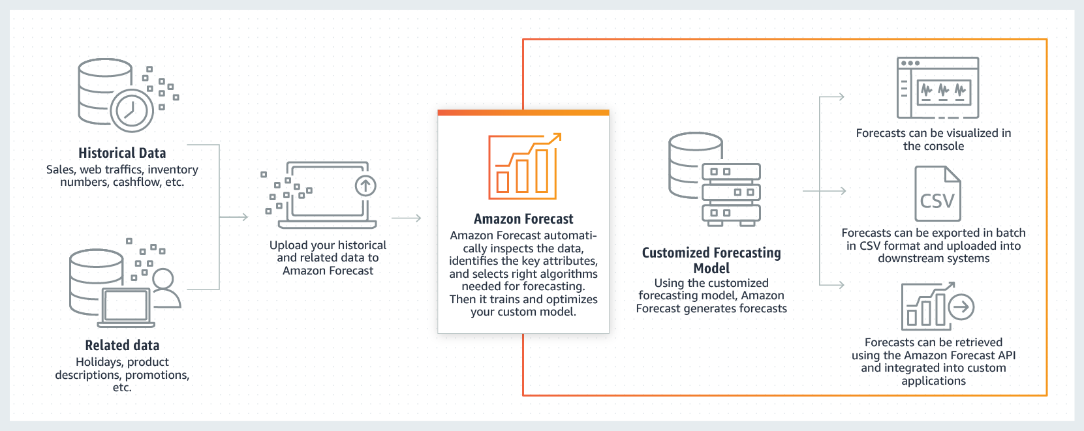
ML model - forecasting

Slide 12
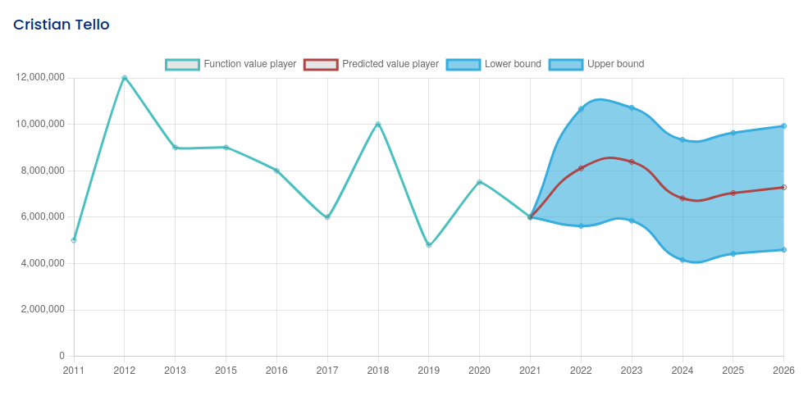

ML - results
Predict goals, assists, minutes played…
Feed the data to our general model and predict the player value

Slide 13
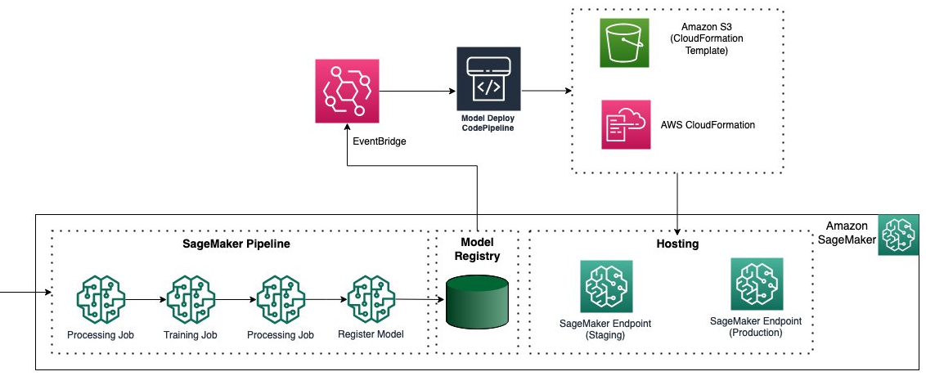
ML model - deployment

Slide 14
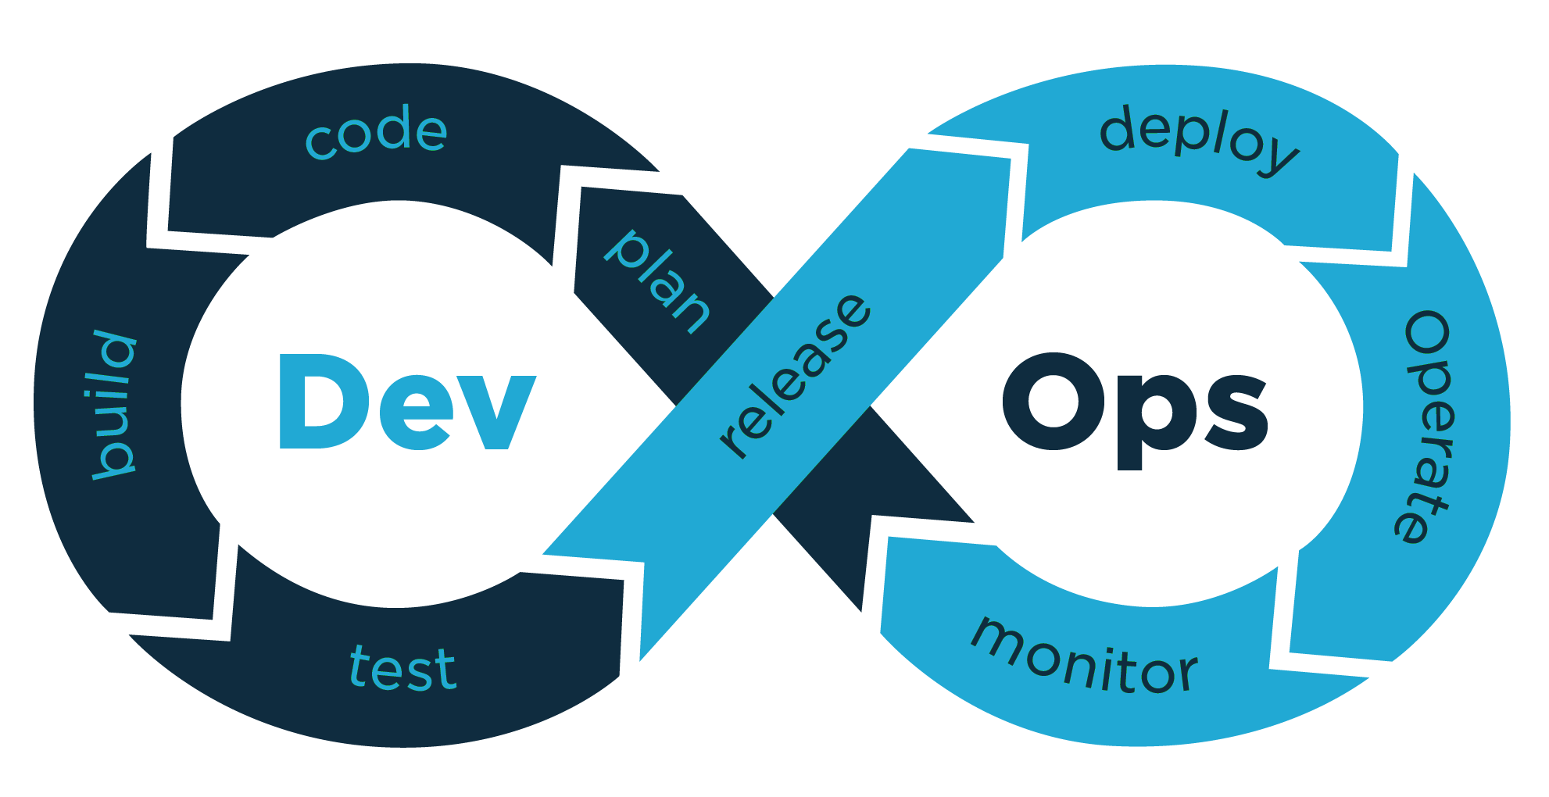
DevOps
Dockerize the application
CI/CD pipeline
AWS auto-deployment
Auto Scaling Instances
…
https://thestandardcio.com/2019/11/18/redes-y-servicios-automatizados-con-devops-marcan-la-nueva-era/
Notes:
Marc

Slide 15
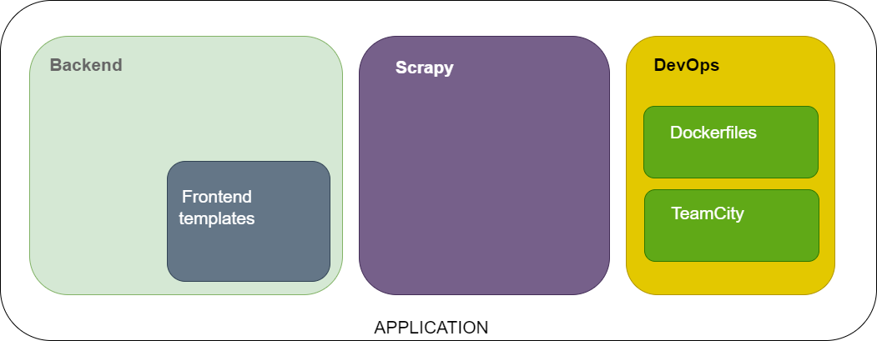
DevOps - Dockerizing the application
Notes:
Marc

Slide 16
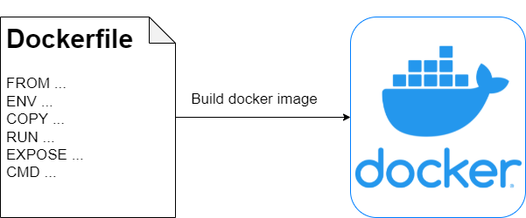
DevOps - Dockerizing the application
Docker image of “backend” directory
Includes Django project + frontend templates
5 steps:
Defined python:3.10 container as FROM instruction
ENV variables
COPY & RUN to install dependencies
EXPOSE port
CMD [‘script/to/run/the/application’]
Notes:
Marc

Slide 17
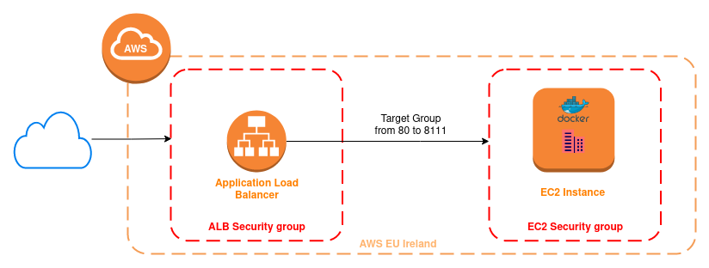
DevOps - CI/CD pipeline
Notes:
Alba

Slide 18



DevOps - Team City
Project: CCBDA
Build configurations
Parameters
Connections
SSH Keys
VCS Root
Build configuration: App
Build steps
Build features
Notes:
Alba

Slide 19
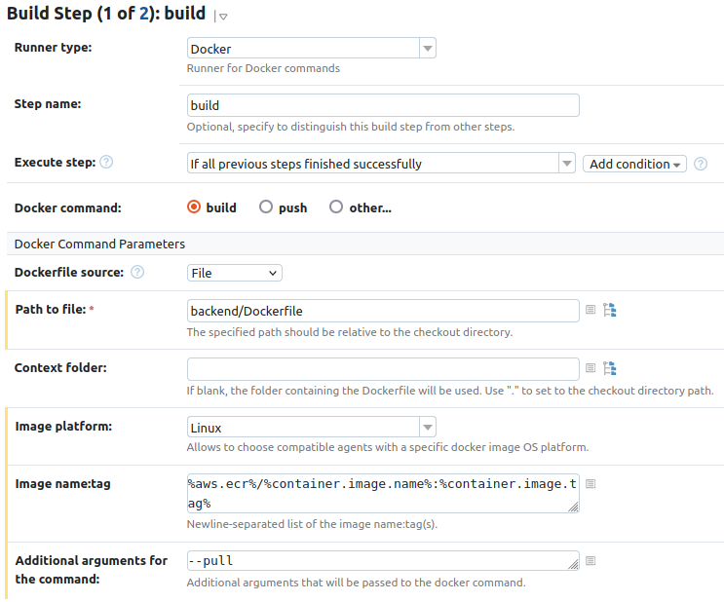
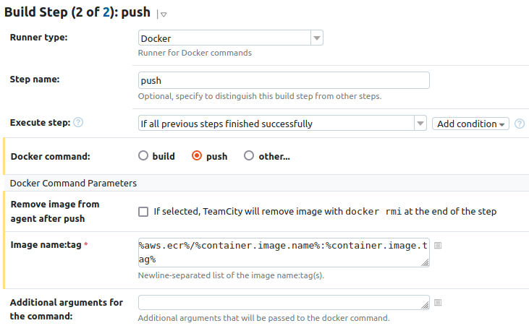
DevOps - Team City: build steps
Notes:
Alba

Slide 20
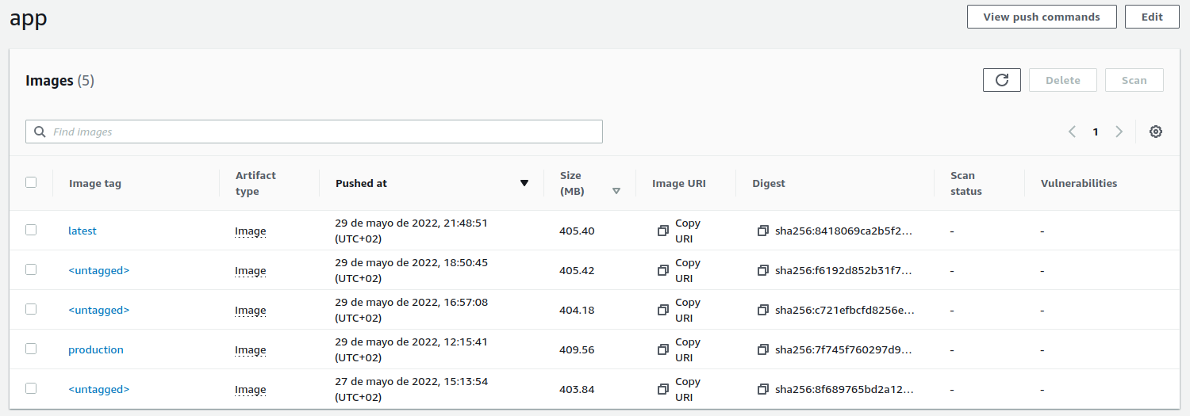
DevOps - AWS ECR
809899697118.dkr.ecr.eu-west-1.amazonaws.com/app
Notes:
Alba

Slide 21
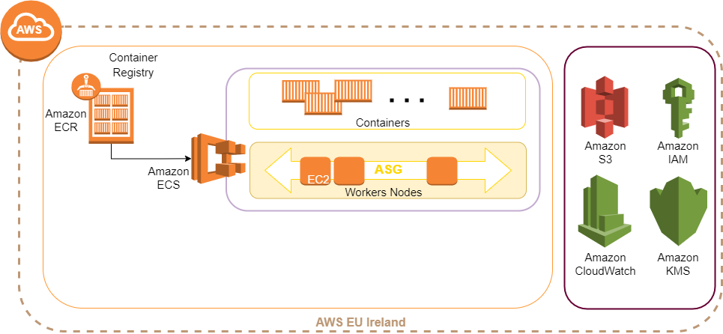
DevOps - AWS Architecture
Notes:
Marc

Slide 22
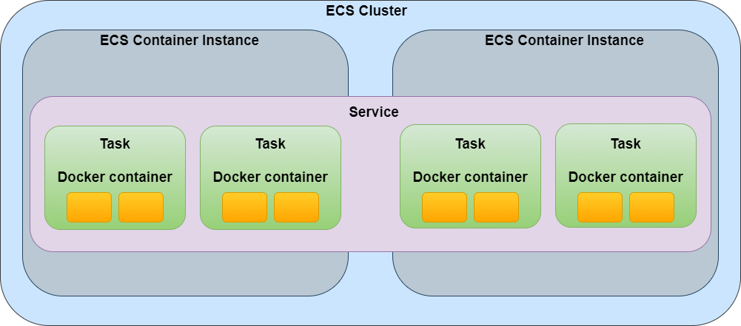
DevOps - AWS ECS
Notes:
Marc

Slide 23
DevOps - AWS ECS
Task definition
Specifies the container information for our application
Use of revisions
Links ECR image with ECS Service
Notes:
Marc

Slide 24
DevOps - AWS ECS
Service
Configuring service parameters
Service type
Task definition
Cluster & Tasks
Adding a load balancer
Setting an Auto Scaling configuration
MIN,MAX #Instances
Monitoring metric variable
Notes:
Marc

Slide 25





DevOps - Entire process
push to master
start CI/CD pipeline
build docker image
push image to ECR
update web app
force new deployment
Notes:
Marc

Slide 26
Future work
Give the user the ability to create more personalized searches by, for example, choosing a range of years to show.
Show all the player's statistics year by year, such as goals scored or assists made.
Give more power to the user to change their data.
Encrypt all the data to avoid possible issues with attackers.
Obtain more data on the players: fouls, tackles, pass accuracy…
Improve our ML model to predict the player value in the future.
Create an AWS pipeline with automated ECR-to-ECS deployment.
To have a staging environment.
Add SSL/TLS encryption.
Dockerize the database with PostgreSQL.
Notes:
Alba

Slide 27
Conclusions
Define all the work to do in parallel in order to avoid possibles struggles.
Different academic backgrounds are useful to have different perspectives for better development.
The implementation of the project has used tools seen in the lab projects and some currently used in the production market.
Notes:
lb-ccbda-prod-657496140.eu-west-1.elb.amazonaws.com:8000

